Slide 1
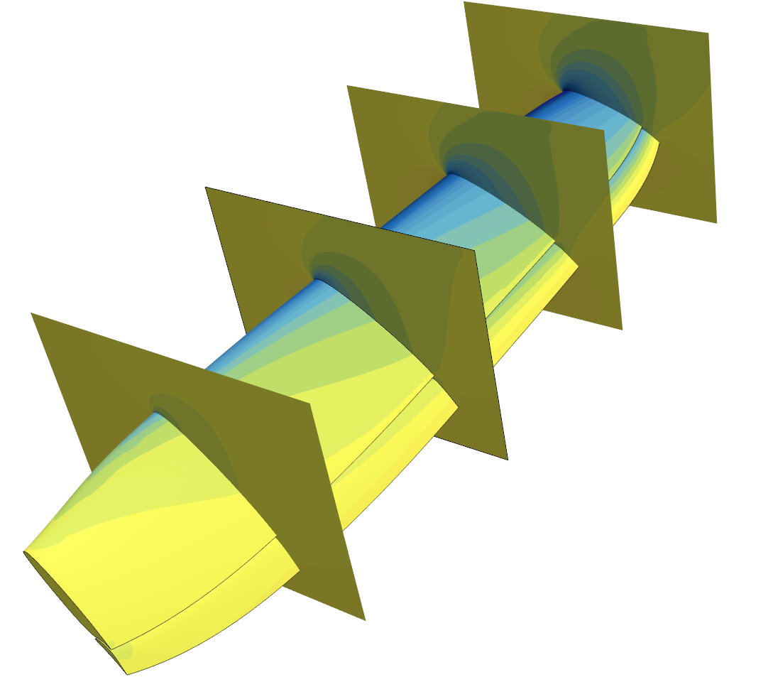
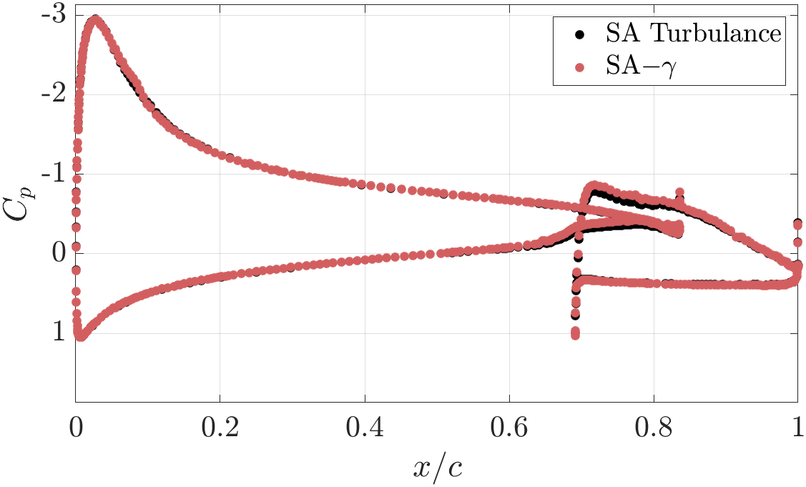
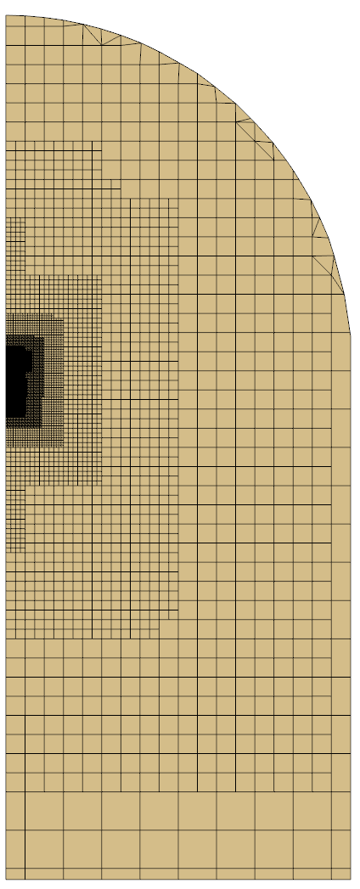
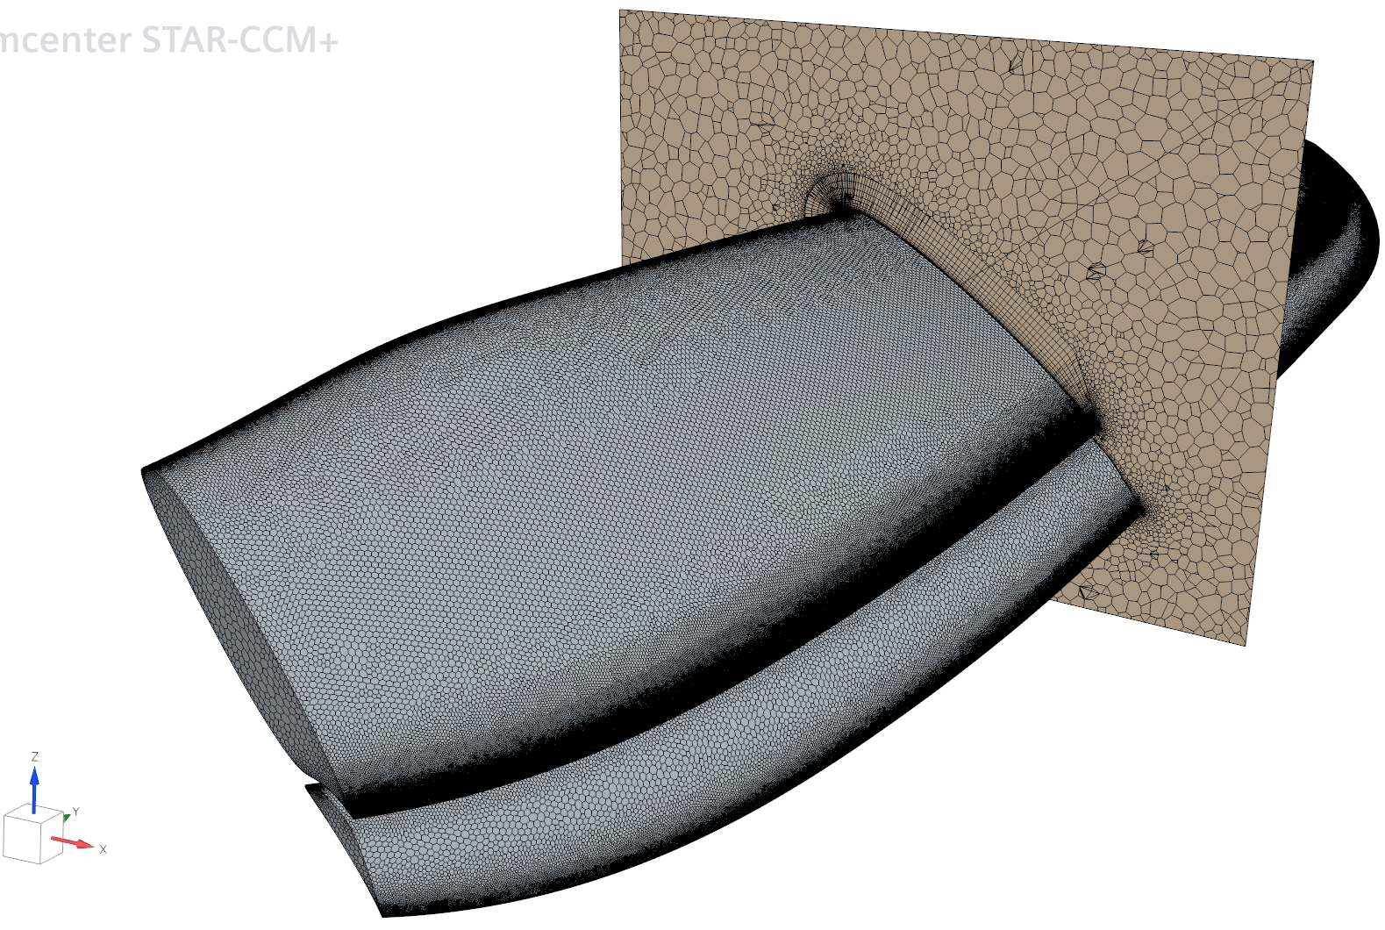
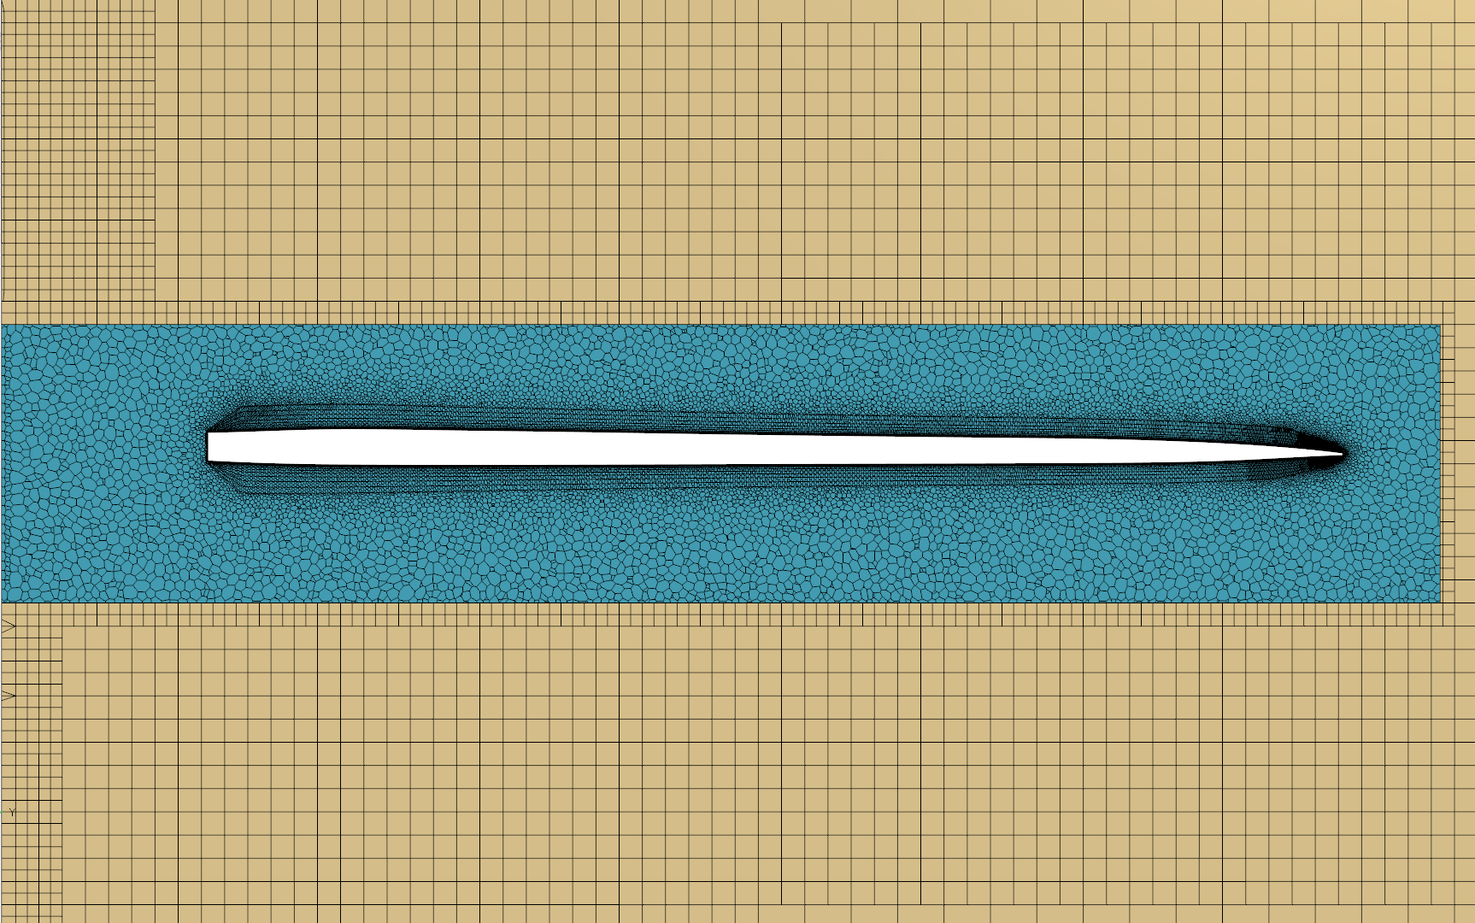
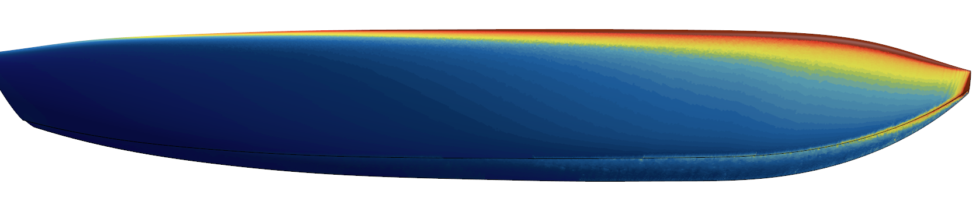
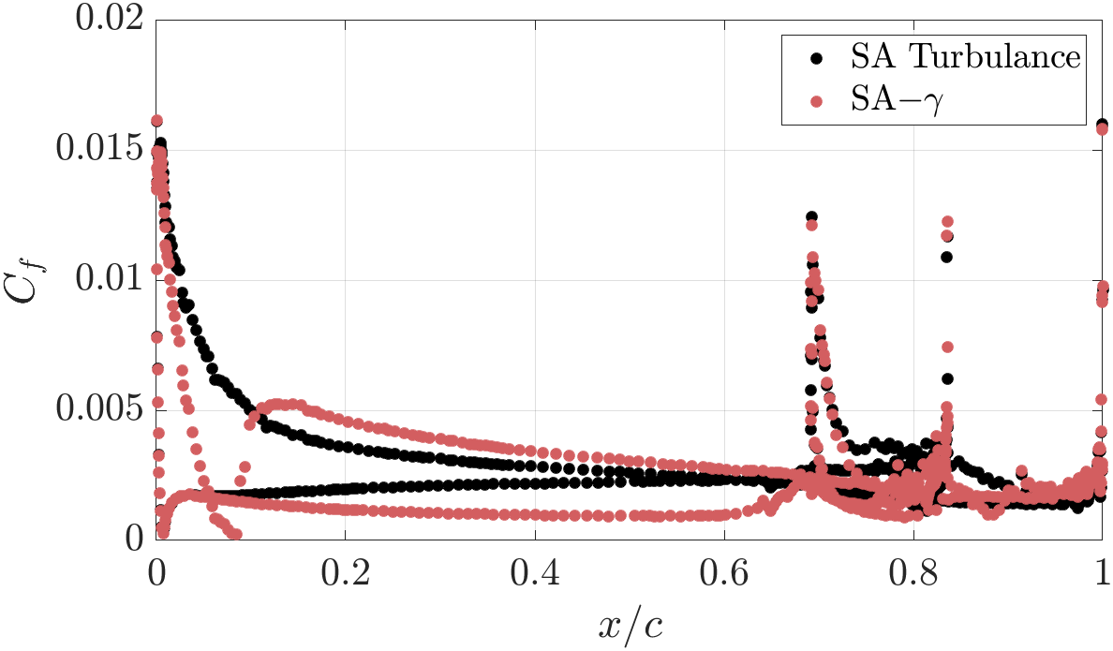
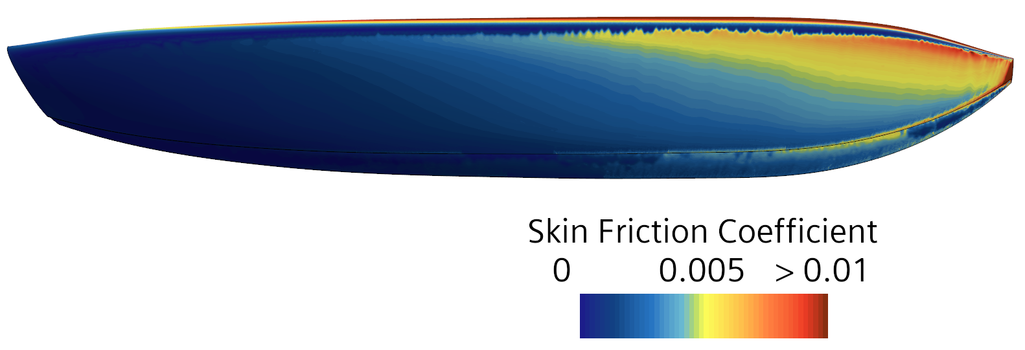
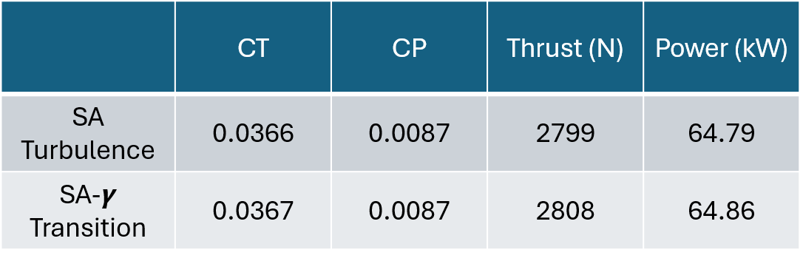
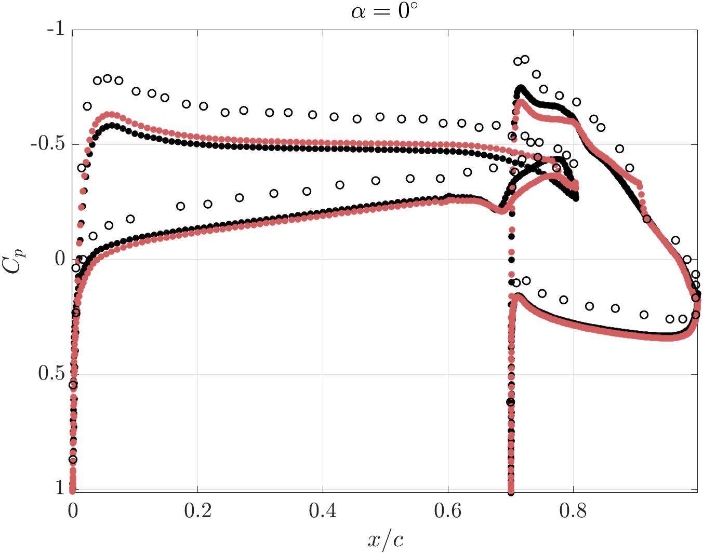
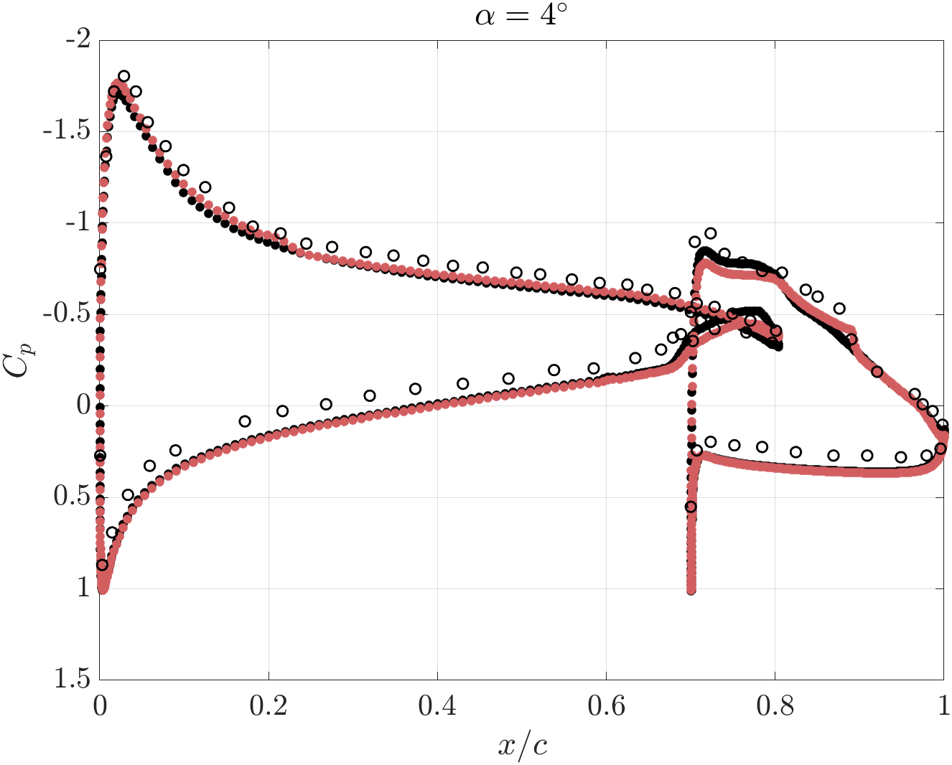
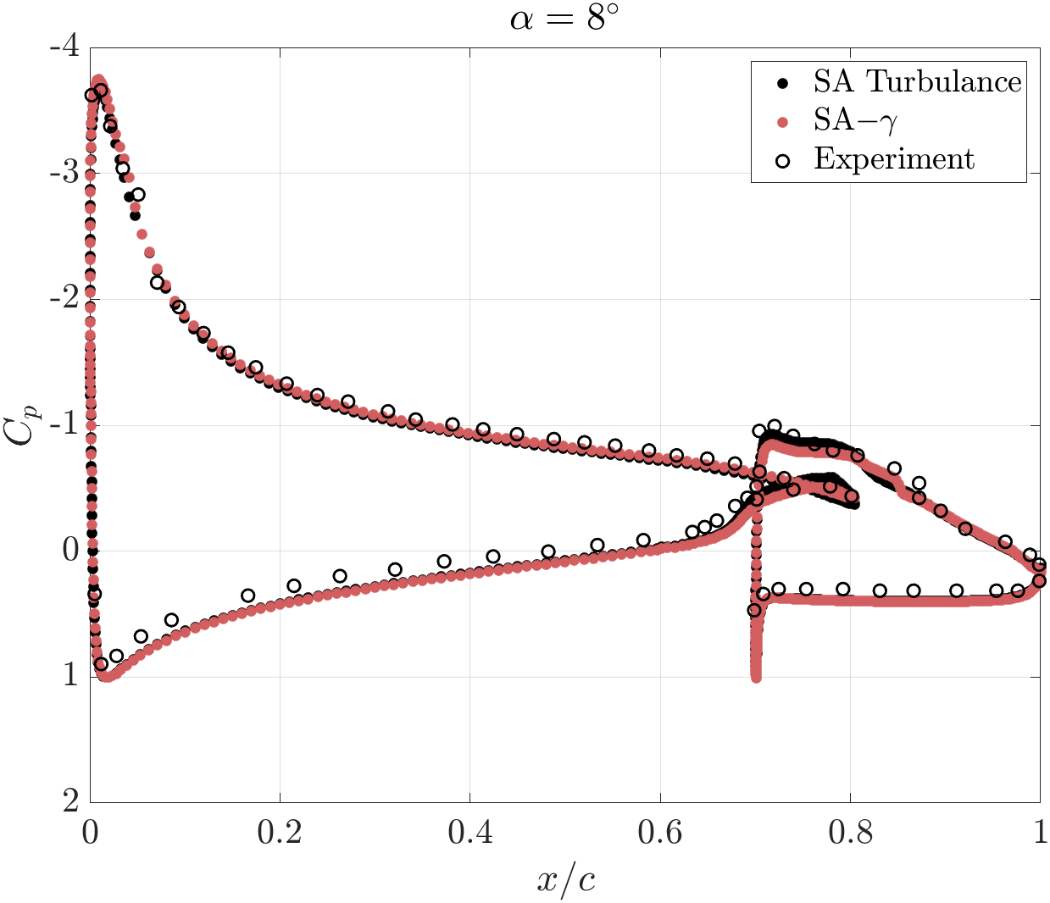
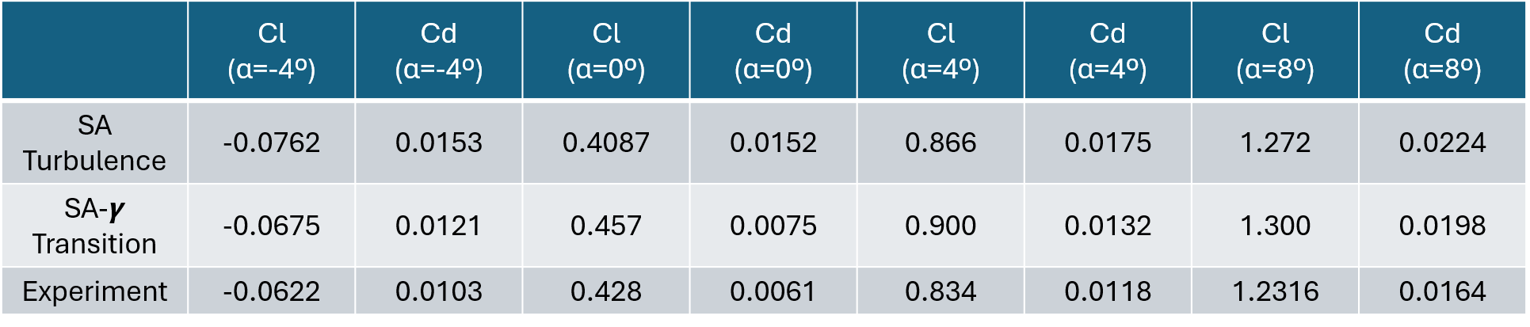
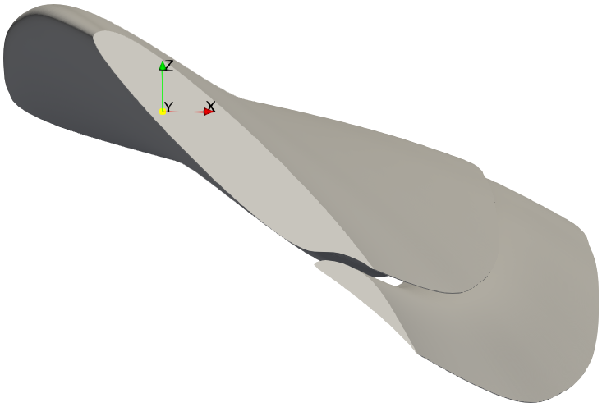
CFD Investigation of an Isolated AAM Rotor Using a Slotted Natural-Laminar-Flow Airfoil
Yisehak A. Keflemariam
Advisor: Dr. James Coder Co-advisor: Dr. Christopher Axten
Department of Aerospace Engineering, Pennsylvania State University
Abstract
Numerical Method
Results
This study investigates the three-dimensional aerodynamic performance and flow characteristics of an isolated Slotted natural-laminar-flow (SNLF) rotor using computational fluid dynamics (CFD).
Pressure distributions, skin friction, thrust, torque, and rotor performance coefficients are evaluated for available turbulence and transition models.
Preliminary results indicate that the SA-𝞬 transition model has a better load prediction at 2D cases, while 3D rotor case needs further improvement.
Steady, blade-resolved Reynolds-Average Navier-Stokes (RANS) simulations were performed on STAR-CCM+ using moving reference frame (MRF) to impose the rotational effect. To reduce computational cost, a single blade is modeled using a 72° periodic sector representing one-fifth of the complete rotor.
A polyhedral mesh with localized refinement is employed in the rotating region, while a trimmed-cell mesh is used in the stationary far-field region. A total of 20 million cells is generated.
Rotating domain
Fig. 4(a): Sectional coefficient of pressure distribution at 70% radial station.
Fig. 4(b): Pressure contours at blade surface and radial stations.
25R
Introduction
Stationary domain
Advanced air mobility (AAM) aircraft require rotor systems capable of producing high aerodynamic efficiency while satisfying demanding performance and acoustic requirements. In this regard, rotor profile losses, boundary-layer transition, flow separation, and tip-vortex formation can substantially influence rotor performance, particularly during hover.
SNLF airfoils provide an alternative to conventional single-element rotor sections, through favorable pressure-gradient control. This arrangement has the potential to maintain extensive laminar flow while providing high lift and relatively low profile drag.
In our previous work [1], the SNLF rotor is proofed to be producing more thrust compared to the baseline AAM rotor in hover. In forward flight, around 1.5% increase in propeller efficiency is also observed. It also contributed to reduction of rotor broadband noise up to OASPL of 2 dB.
The effect of Spalart-Allmaras intermittency transition model on simulating aerodynamic performances is presented here.
30R
20R
Fig. 5(a): Skin friction coefficient distribution at 70% radial station.
Fig. 5(b): Skin friction coefficient on upper surface for SA Turbulence (top) and SA-𝞬 Transition model (bottom).
Fig. 2: Computational domain and surface mesh.
Results
Validation using 2D case
A 2D simulation cases are used to validate the standard SA turbulence model and SA-𝞬 transition model against experimental data [2].
Rotor performance
The difference between the two SA models is significant on skin-friction coefficient, where SA-𝞬 transition model resulted much lower Cf around the leading edge of the rotor.
Table 2: Comparison of integrated values for the two models.
Conclusion
It is observed that the SA-𝞬 transition model can improve the Cd prediction up to 75 count at 2D cases.
However, this improvement is not reflected on the steady 3D case, one reason being lower mesh resolution at the tip.
Fig. 3: Coefficient of pressure comparison for SA Turbulence and SA-𝞬 Transition models, against experimental data at angle of attack (𝞪) of 0, 4, and 8 degrees.
Future Work
Unsteady rotor simulation at refined mesh size, and solving FW-H equation for noise prediction
Implementing AFT transition model
Table 1: Sectional lift and drag coefficient table at different 𝞪.
Reference
Axten, C., Keflemariam, Y., & Coder, J., “Assessment of a slotted, natural-laminar-flow airfoil for advanced air mobility applications,” 81st Annual VFS Forum. 2025
Somers, D., and Maughmer, M., “Design and Experimental Results for a Low-Speed, Flapped, Slotted, Natural-Laminar-Flow Airfoil,” NASA/CR-2022-0014964, 2022.
Fig. 1: SNLF rotor blade geometry.

